Slide 1
E-Commerce Data Analysis with TaoBao Users’ Behaviors --Data Mining Final Project
Team Students: Jiang Yuchen, Li Yuanzhao, Chen Jiyuan, Shang Jihao

Slide 2

Outline
Topic preview
Task Design
IV. Experiment Result
V. Summary

Slide 3
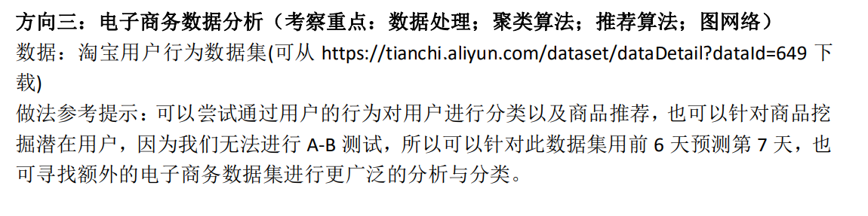
I. Topic Preview
First, our team members looked through all topics together with their datasets described in document.
Then, we reached an agreement that topic 3 will be chosen as final project’s topic.
Since we have done the literature review on this topic several weeks ago, we are familiar with it.
Figure.1 Topic 3 Description

Slide 4
II. Task Design
We decide to start our project with three aspects
First, //TODO
Second, analyze data, build up users’ behavior matrix and apply Non-negative Matrix Factorization(NMF) to it in order to find out the potential user toward certain item.
Third, //TODO

Slide 5
II. Task Design
//TODO Task 1 description
Figure.

Slide 6
II. Task Design
//TODO Task 1 description
Figure.

Slide 7
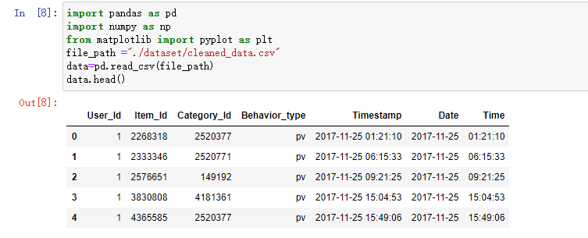
II. Task Design
For task 2, we also do data clean first, which drop duplicate data and unreasonable data.
We save cleaned data so that it can be taken into use quickly.
Figure. Cleaned data

Slide 8
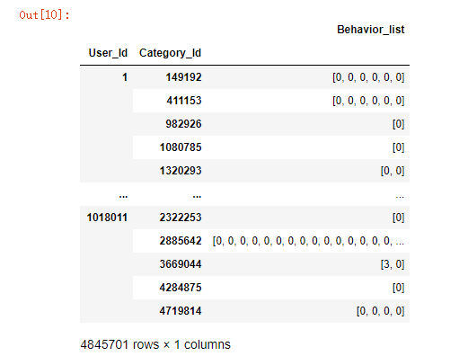
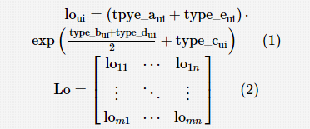

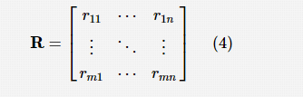
II. Task Design
Then, we contruct the dataframe group by User_id and Category_id.After that, we fill in the m*n matrix(m represents users, n represents items) with the information shown right.
Figure. Behaviors Dataframe
Figure. Equation for Matrix Content

Slide 9
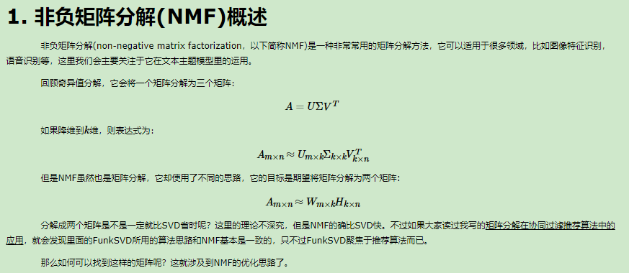
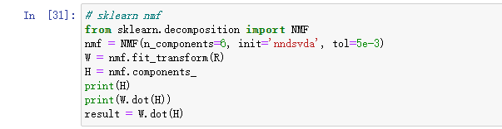
II. Task Design
Then, apply NMF to the matrix.For matrix R, we want to decomposite it into W(user feature matrix)and H(item feature matrix) matrix. However, the product of W and H is different from original R.Thus, we need to minimize the difference.
Figure. NMF definition
Figure. Sklearn NMF method

Slide 10
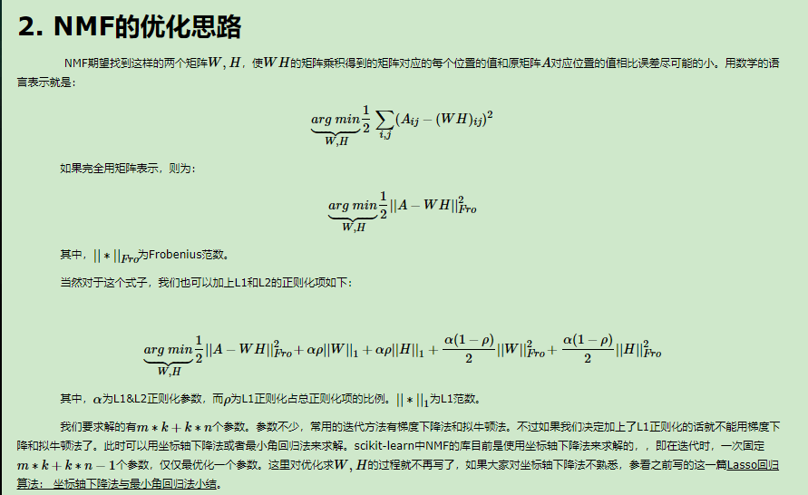
II. Task Design
NMF provides such function. So we apply sklearn.decomposition.NMF() to matrix R and get the result.
Figure. Sklearn NMF optimization

Slide 11
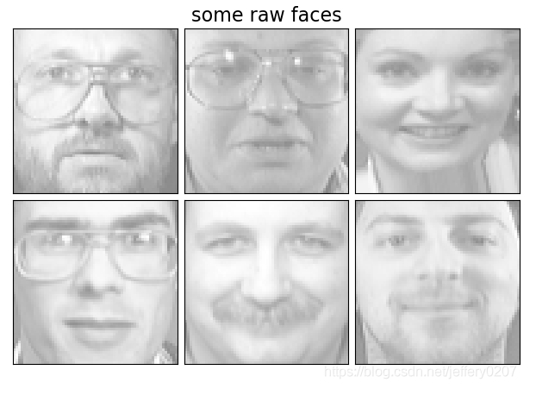
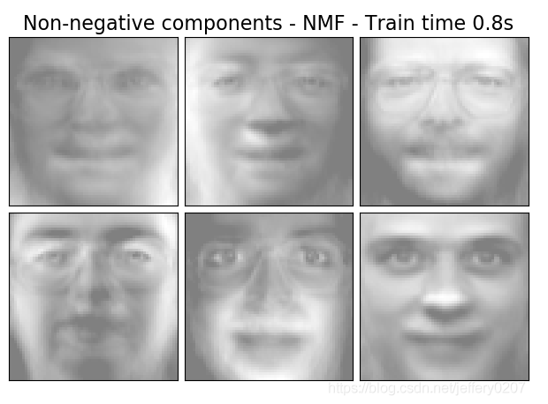
II. Task Design
Reality usage:
According to current behaviors, we can judge whether the user is interested in other items which doesn’t have interaction with users.
Potiential Coefficient
Figure. Reality usage of NMF in CV

Slide 12
II. Task Design
//TODO Task 3 description
Figure.

Slide 13
II. Task Design
//TODO Task 3 description
Figure.

Slide 14
III. Experiment
Task 1:
Figure.

Slide 15
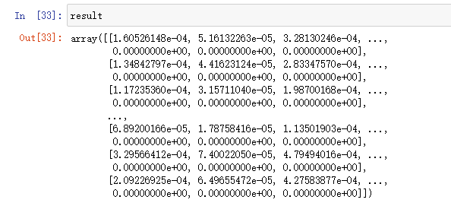
III. Experiment
Task 2:
198000 * 8562 Matrix
The content [x,y] is Potiential Coefficient for user x with item y
(If we have real label for such Potiential Coefficient, we can train our model with parameters which I set on my own.)
Figure. Result Matrix

Slide 16
III. Experiment
Task 3:
Figure.

Slide 17

IV. Summary
This model successfully takes use of privileged features in recommend system and and get a better performance both theoretically and practically
This kind of model may also be used in not only recommend system but also other field which also need to take use of posterior data
Figure.10 E-Life

Slide 18
Reference
[1]

Slide 19

Thanks for watching！

